Slide 1
Fire Prediction
Group Project
Jess Napper, Anirudh Revathi, Ruben Castaing,
Roman Naumov, Dimitrii Ustinov
JARRD Group at DATA472 Course
University of Canterbury
New Zealand
22.05.2024

Slide 2

Goal of the project
The client wishes to know where to place IOT fire detecting sensors for early fire detection
Determine the fire risk throughout the city of Christchurch and identify areas of high risk so that they can be monitored closely

Slide 3
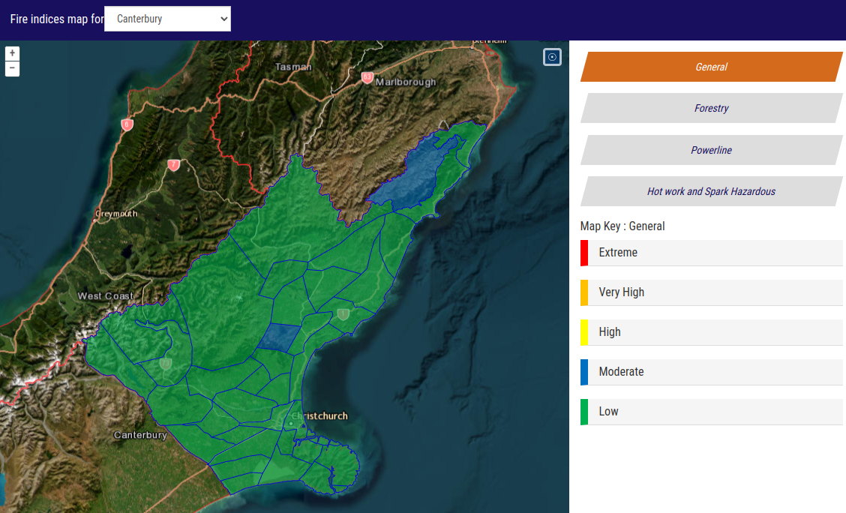
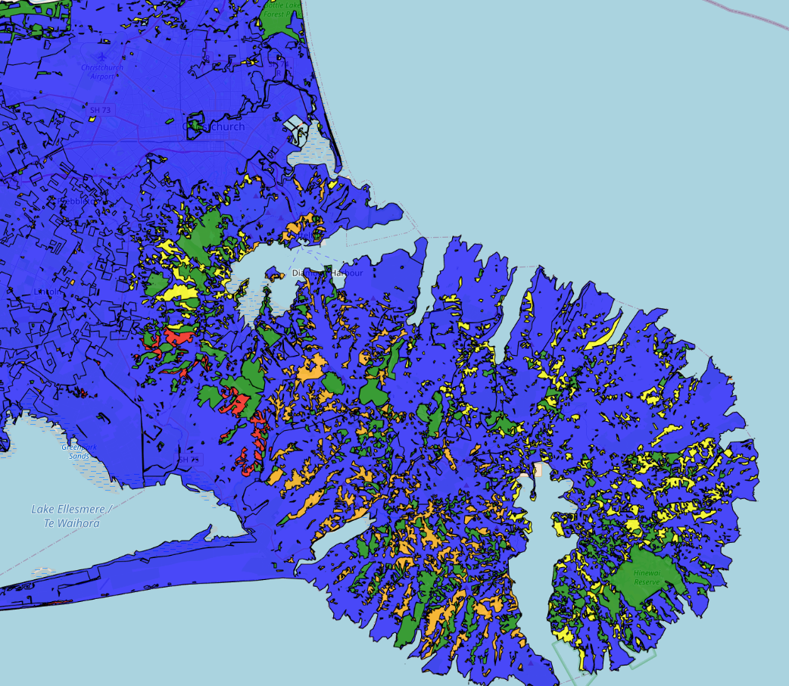
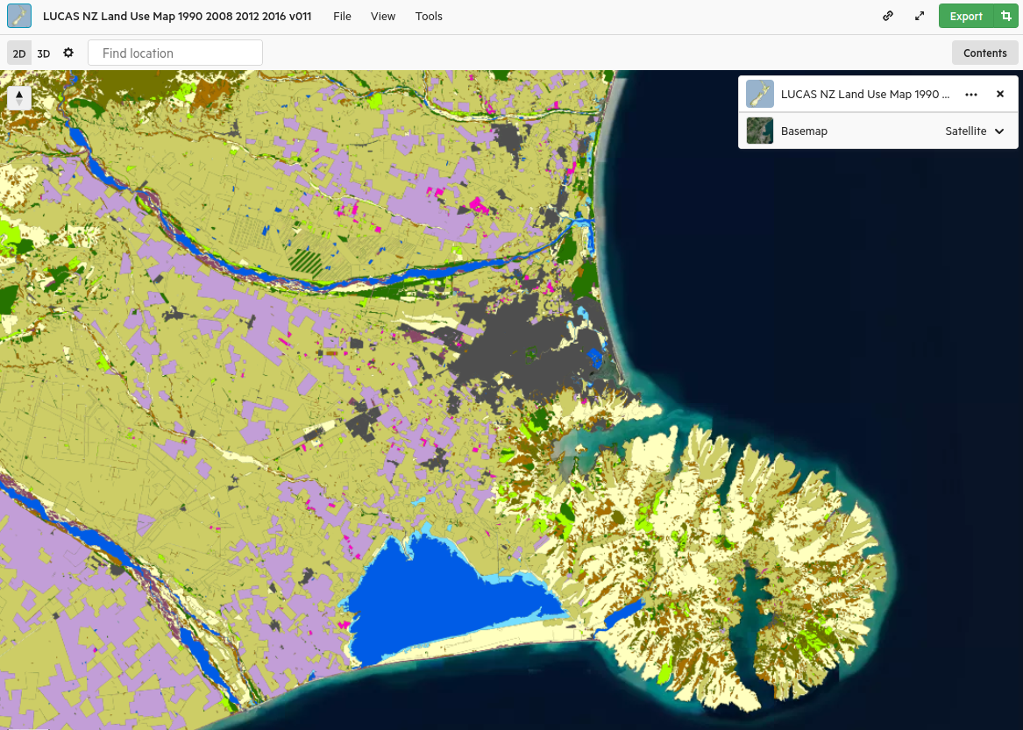
Input and Output

Slide 4
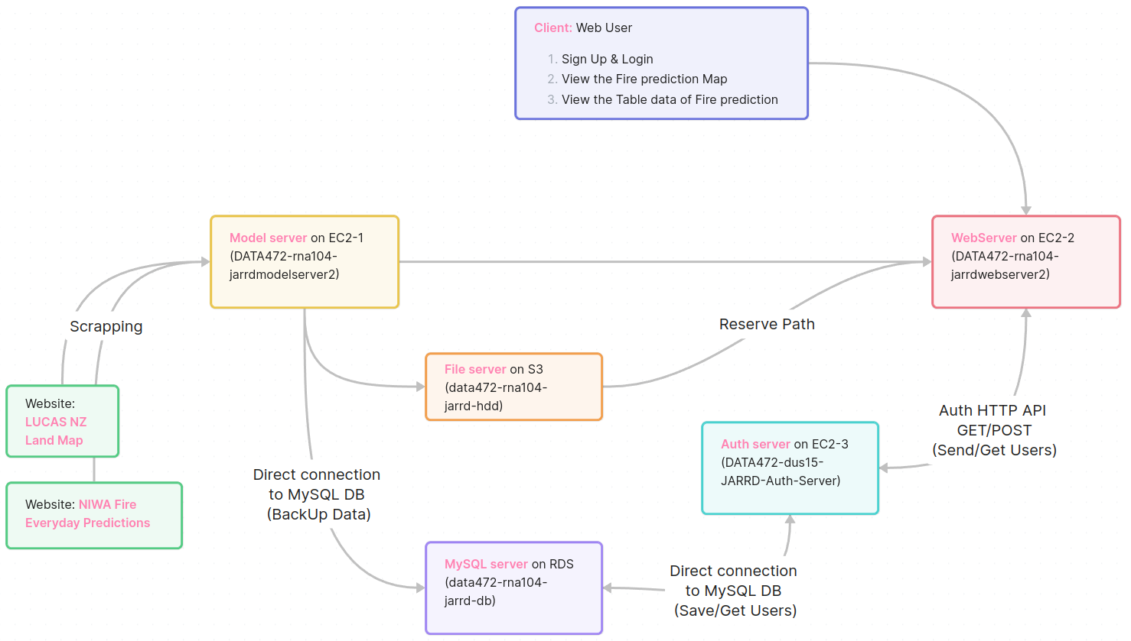
Architecture of the system
User
Scrapping Layer
Model Layer
Storage Layer
Auth Layer
Web server Layer
System

Slide 5
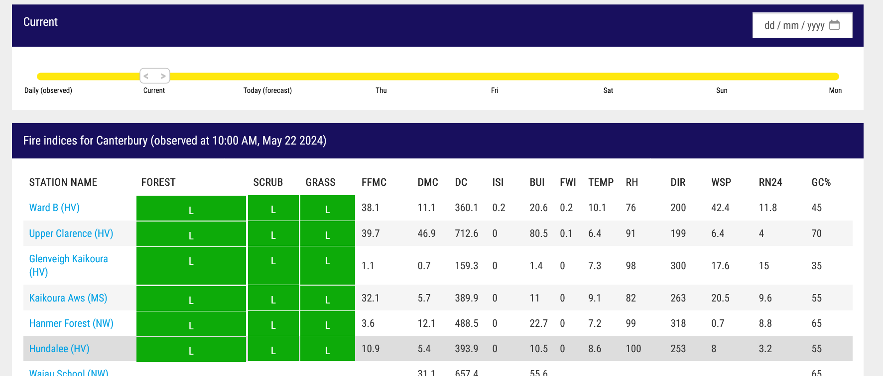
Scrapping Layer
Workflow:
Uses Selenium to read the Niwa’s Website
Uploaded to an EC2 instance

Slide 6
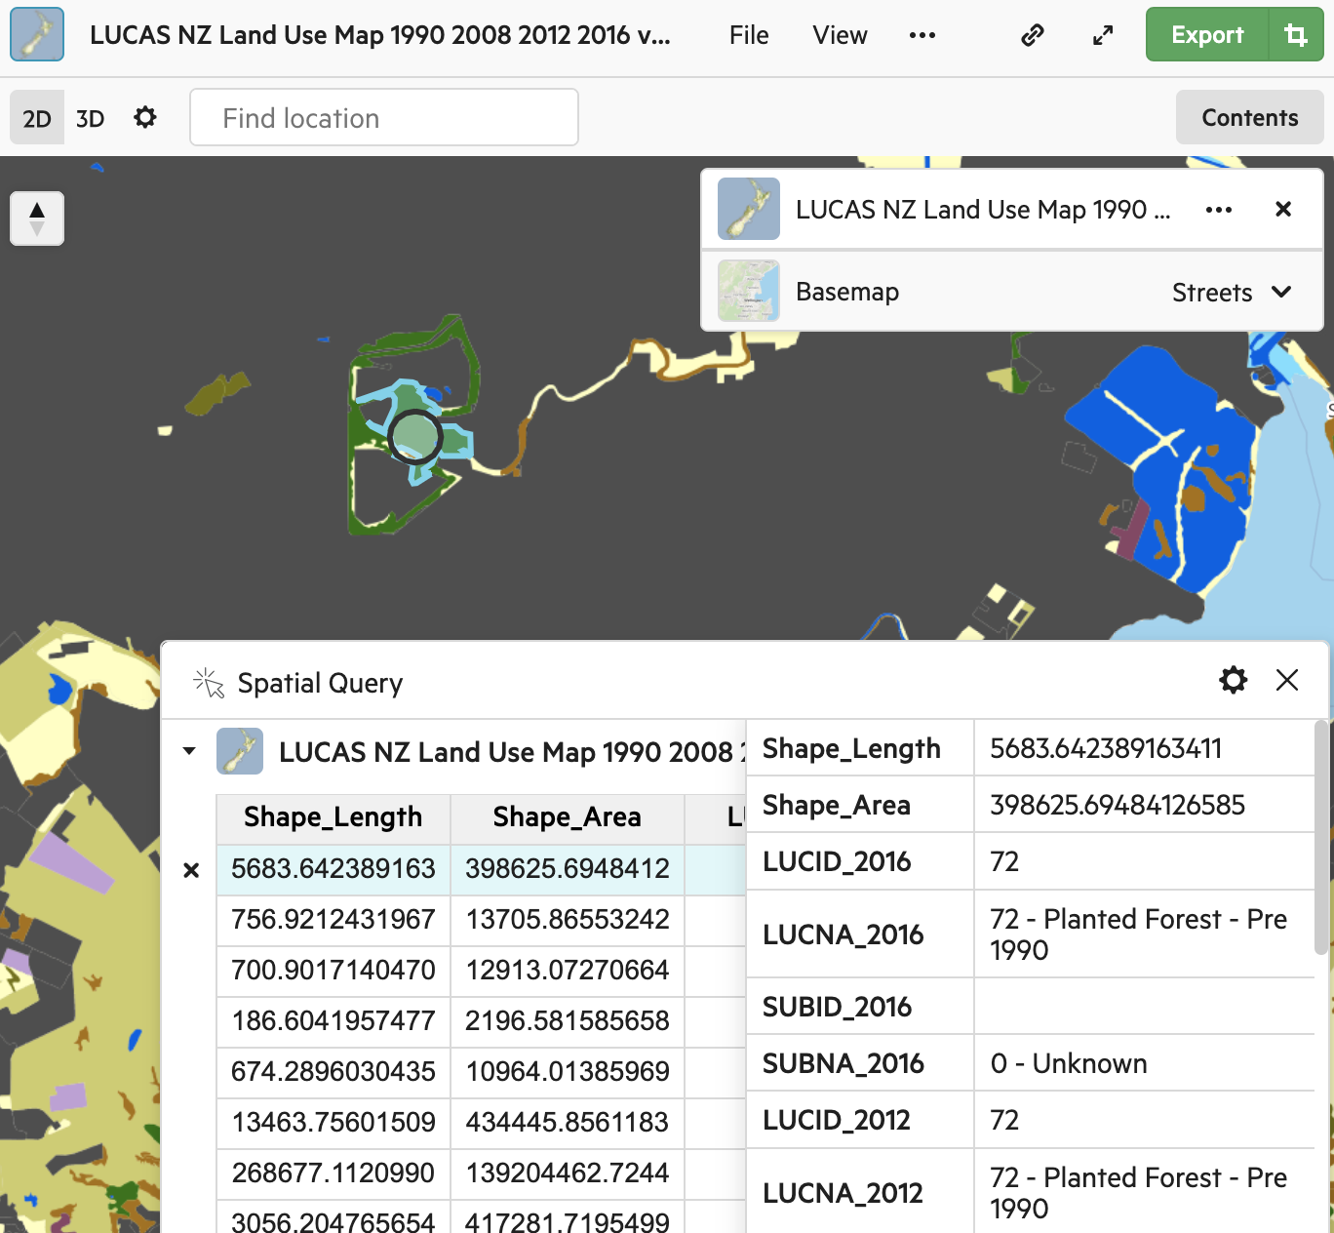
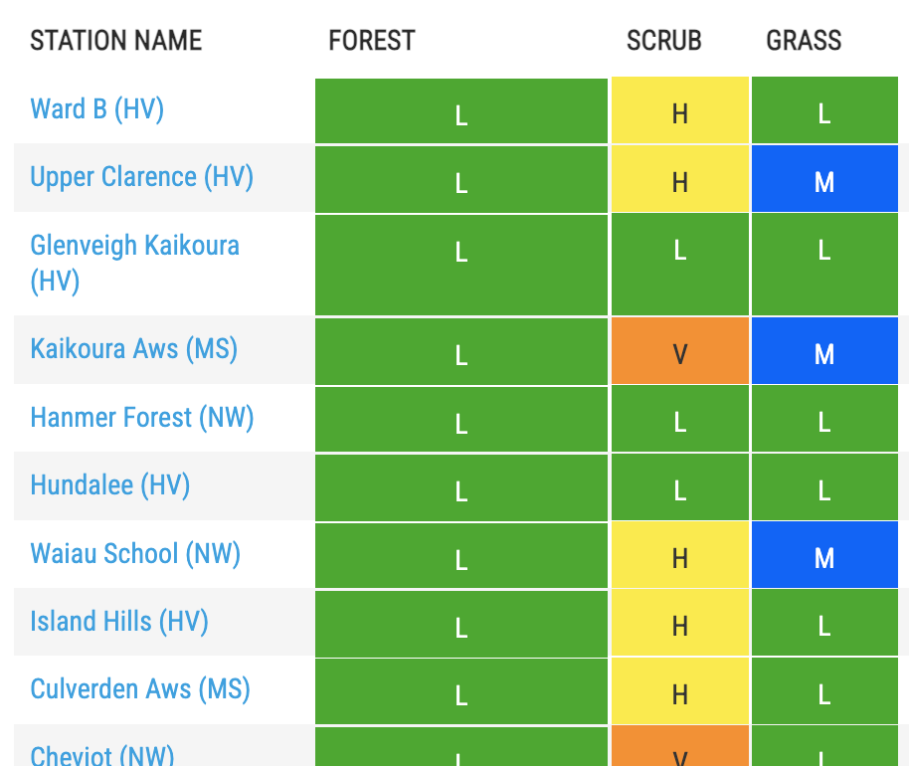

Model Layer

Slide 7
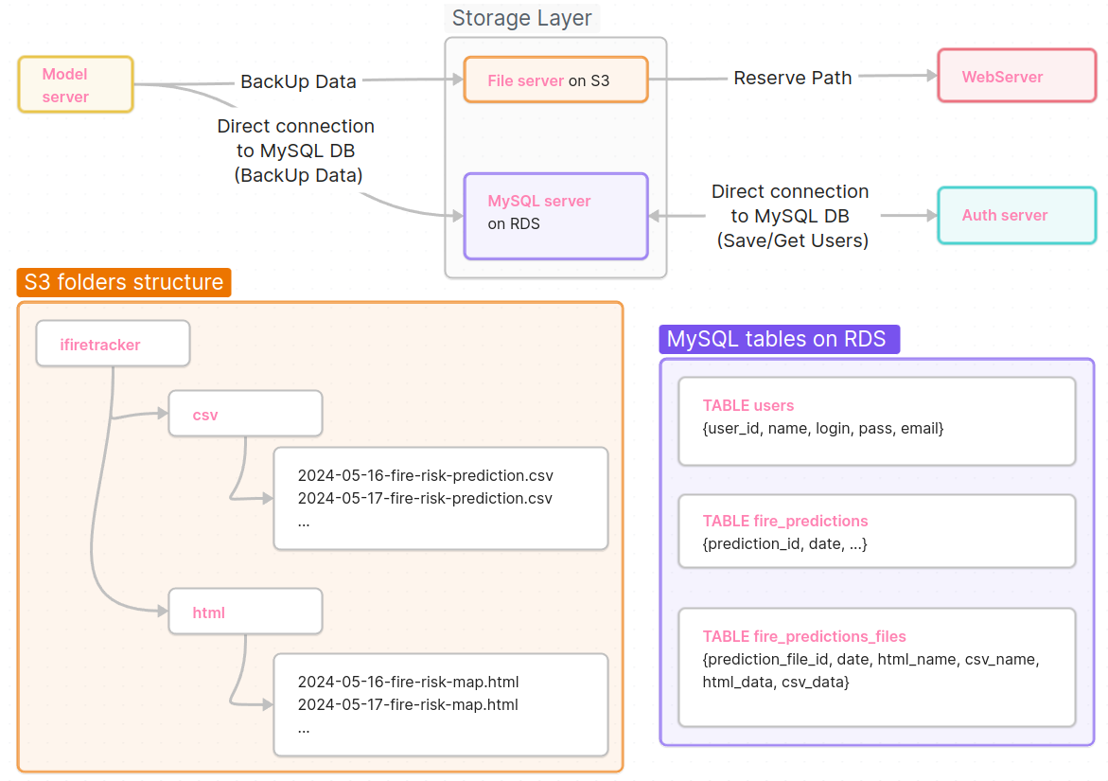



Storage Layer

Slide 8
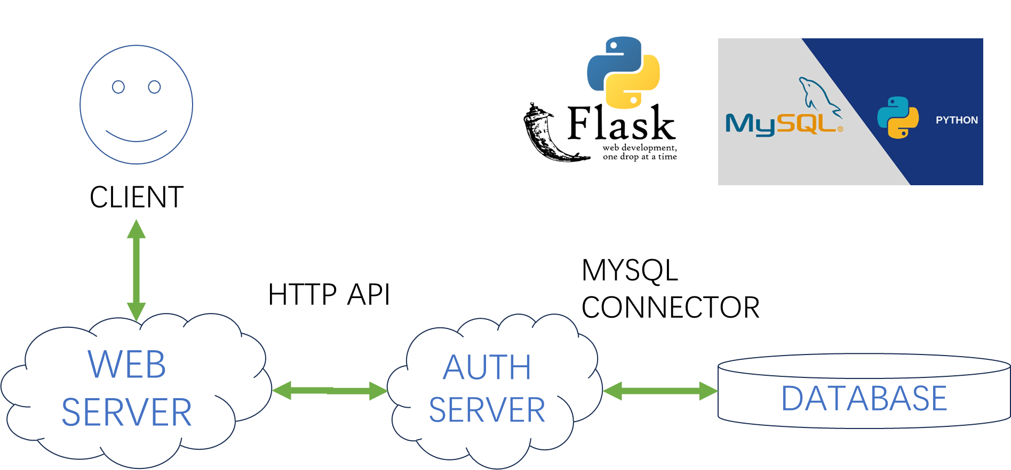
Authorization Layer
EC2
EC2
RDS

Slide 9
Web server Layer
Login / Register
Username
Web server (EC2)
HTTP requests
Password
Framework: Flask, gunicorn, Nginx
Interacts with web server via HTTP API through GET/POST requests

Slide 10

The iFireTracker Demo is here:
http://54.66.144.170/

